Slide 1
The Bill of Rights - 1791

Slide 2
Background to the Bill of Rights
Key issue to getting the Constitution ratified
Introduced by James Madison to Congress
12 amendments were proposed to the states for ratification
Only ten of the amendments were passed: These became known as the Bill of Rights
Two amendments didn’t pass: 1. An amendment dealing with apportionment in the House of Representatives 2. Amendment dealing with Congressional pay (gets passed in 1992)

Slide 3
Date Created:
Bill of Rights proposed to Congress:
September 25, 1789
Bill of Rights ratified:
December 15, 1791

Slide 4
The First Amendment
Congress shall make no law respecting an establishment of religion, or prohibiting the free exercise thereof; or abridging the freedom of speech, or of the press; or the right of the people peaceably to assemble, and to petition the Government for a redress of grievances.

Slide 5
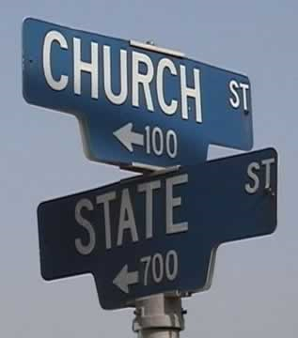
The First Amendment
Freedom of Religion: Establishment Clause, Free Exercise Clause

Slide 6
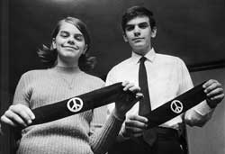
Freedom of Speech
In 1965, 13-year old Mary Beth Tinker and her 15-year old brother John wore black armbands to school in Des Moines, Iowa. They wanted to show their mourning for people killed in the Vietnam War and their support for a truce at Christmas. Mary Beth, an eighth grade student at Harding Jr. High School was promptly suspended by her principal, who said no black armbands would be allowed.

Slide 7
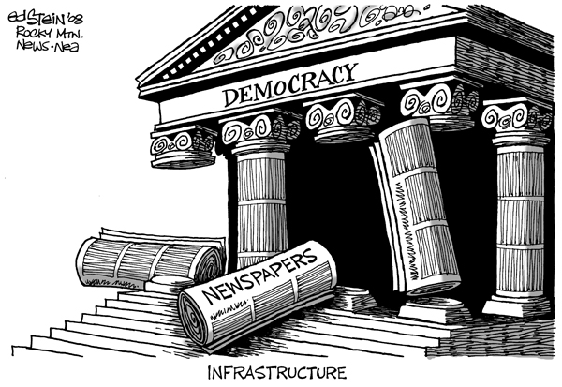
Freedom of the press

Slide 8
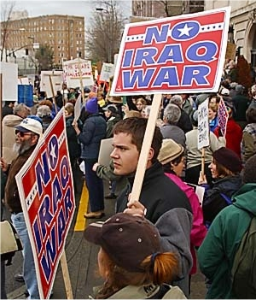
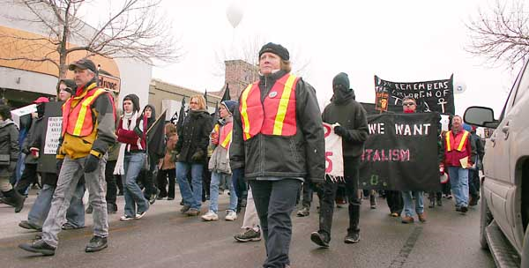
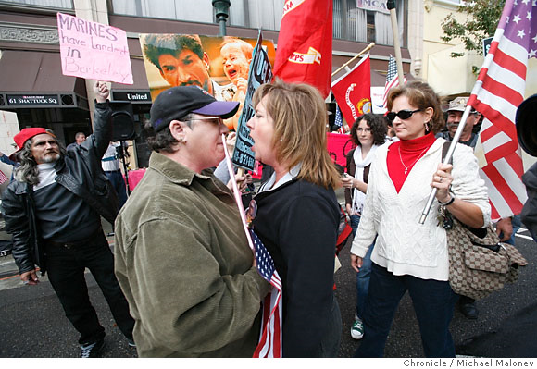
Freedom of Assembly

Slide 9
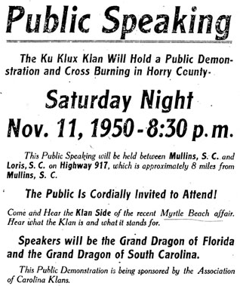
Handbill advertising a rally of the Association of Carolina Klans

Slide 10
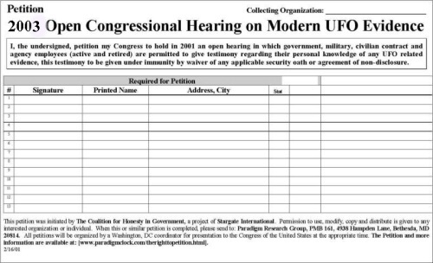
Right to petition

Slide 11
The Second Amendment
A well regulated Militia, being necessary to the security of a free State, the right of the People to keep and bear Arms, shall not be infringed.

Slide 12
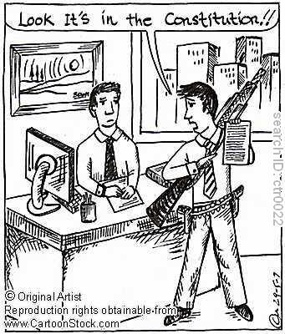
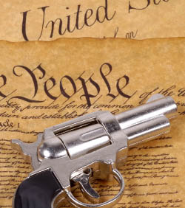
Right to Bear Arms

Slide 13
The Third Amendment
No Soldier shall, in time of peace be quartered in any house, without the consent of the Owner, nor in time of war, but in a manner to be prescribed by law.

Slide 14
The Fourth Amendment
The right of the people to be secure in their persons, houses, papers, and effects, against unreasonable searches and seizures, shall not be violated, and no warrants shall issue, but upon probable cause, supported by Oath or affirmation, and particularly describing the place to be searched, and the persons or things to be seized.

Slide 15
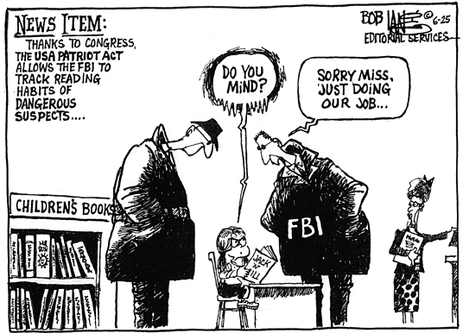
The Fourth Amendment
Protection from unreasonable search and seizure

Slide 16
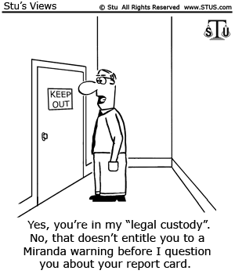

Slide 17
The Fifth Amendment
No person shall be held to answer for any capital, or otherwise infamous crime, unless on a presentment or indictment of a grand jury, except in cases arising in the land or naval forces, or in the Militia, when in actual service in time of War or public danger; nor shall any person be subject for the same offence to be twice put in jeopardy of life or limb; nor shall be compelled in any criminal case to be a witness against himself, nor be deprived of life, liberty, or property, without due process of law; nor shall private property be taken for public use, without just compensation.

Slide 18
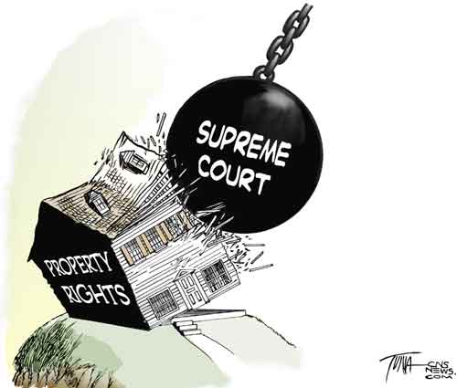
The Fifth Amendment
Due process, double jeopardy, self-incrimination, eminent domain

Slide 19
The Sixth Amendment
In all criminal prosecutions, the accused shall enjoy the right to a speedy and public trial, by an impartial jury of the State and district where in the crime shall have been committed, which district shall have been previously ascertained by law, and to be informed of the nature and cause of the accusation; to be confronted with the witnesses against him; to have compulsory process for obtaining witnesses in his favor, and to have the Assistance of Counsel for his defense.

Slide 20
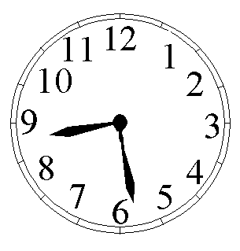
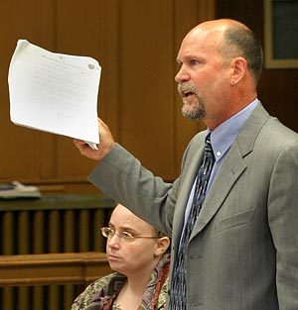
The Sixth Amendment
Confrontation Clause, Rights of the accused; speedy trial, public trial, right to counsel, Change of Venue

Slide 21
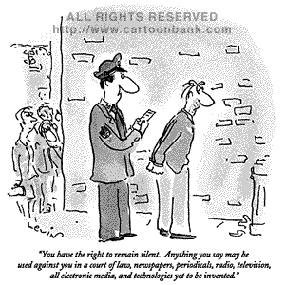

Slide 22
The Seventh Amendment
In suits at common law, where the value in controversy shall exceed twenty dollars, the right of trial by jury shall be preserved, and no fact tried by a jury, shall be otherwise re-examined in any court of the United States, than according to the rules of the common law.

Slide 23
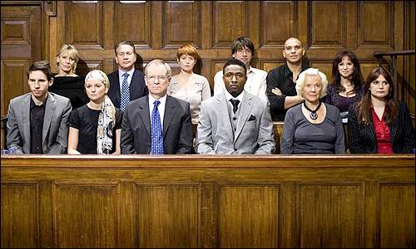
The Seventh Amendment
Civil trial by jury
Today - $1500

Slide 24
The Eighth Amendment
Excessive bail shall not be required, nor excessive fines imposed, nor cruel and unusual punishments inflicted.

Slide 25
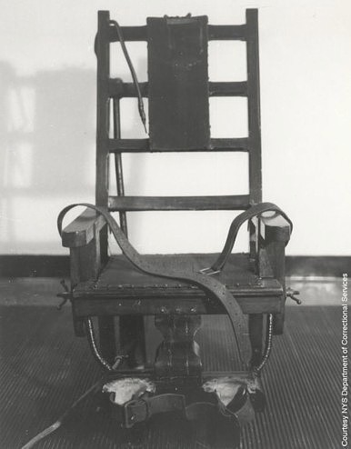
The Eighth Amendment
Prohibition of excessive bail and cruel and unusual punishment.

Slide 26
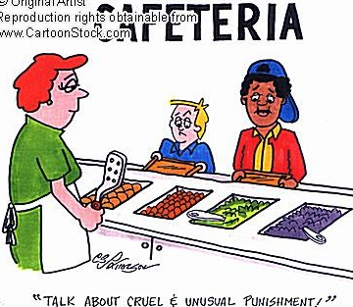

Slide 27
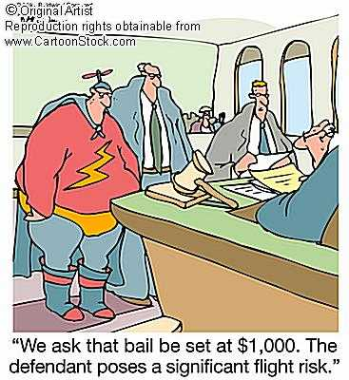

Slide 28
The Ninth Amendment
The enumeration in the Constitution, of certain rights, shall not be construed to deny or disparage others retained by the people.

Slide 29
The Ninth Amendment
Protection of rights not specifically enumerated in the Bill of Rights.
Just in case we forgot any, you can’t violate those either.

Slide 30
The Tenth Amendment
The powers not delegated to the United States by the Constitution, nor prohibited by it to the States, are reserved to the States respectively, or to the people.

Slide 31
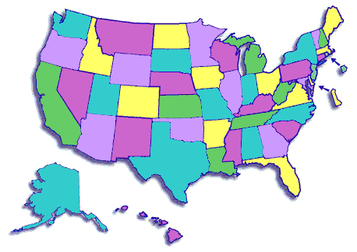
The Tenth Amendment
Powers of States and people.
If the power isn’t given to the federal government, it belongs to the states and the people.

Slide 32
The Problems with Rights
Expanding Rights

